Slide 1

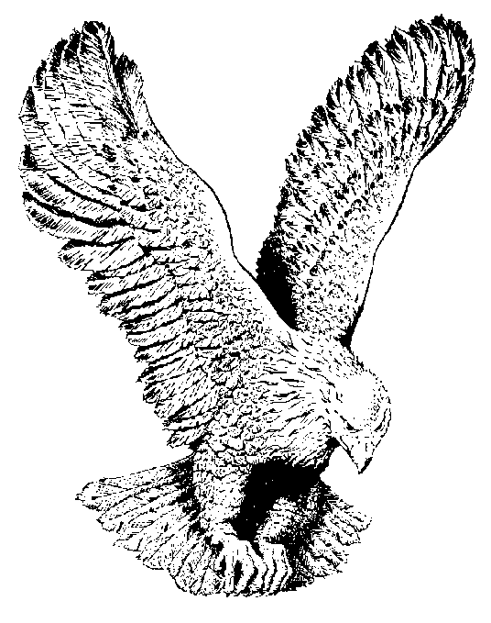
797 BREAKING OF THE DAY
O, it must be the breaking of the day
O, it must be the breaking of the day
The night is almost gone
The day is coming on
O, it must be the breaking of the day.

